Slide 1
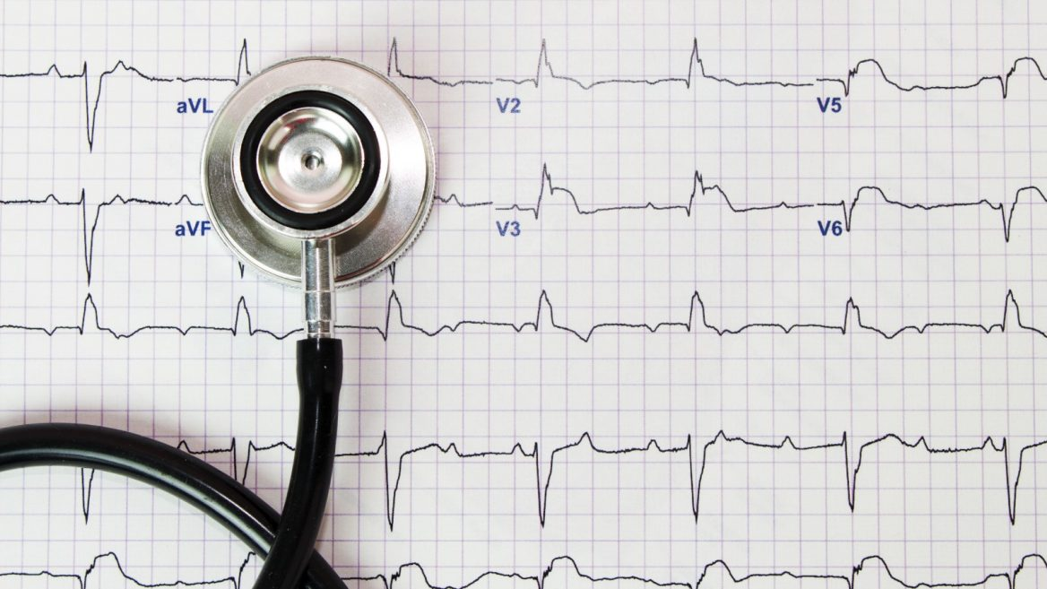
FETAL DISTRESS
CLASSIFICATION OF
USING PREDICTIVE ANALYTICS

Slide 2






MEET THE TEAM
SHASHANK SHEKHAR
MOHIT KUMAR SAINI
DEBAJYOTI PODDER
SOURAV MAJI
AMIT AGARWAL
AGASTYA BHOOSAN

Slide 3
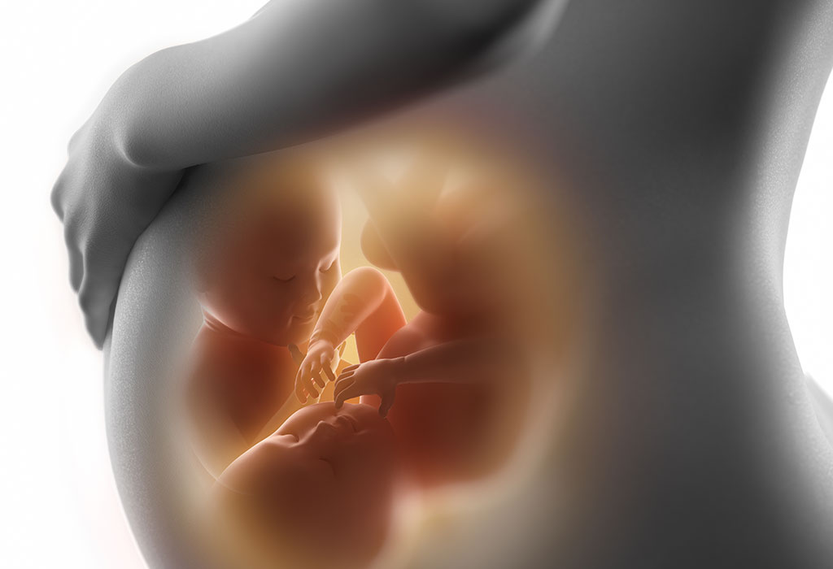
INTRODUCTION
WHAT IS CARDIOTOCOGRAPHY?
Cardiotocography is a technique that is used to monitor the heartbeat of the fetus along with keeping a check on uterine contractions. This can be deciphered from the name itself – cardio (heart) toco (uterine contractions) and graph (recording)
WHEN IS CARDIOTOCOGRAPHY USED?
A CTG Test during pregnancy is usually performed during the third trimester as well as during labor. The correct utilization of this test can help prevent the baby from dying due to a shortage of oxygen.
WHAT CAN CARDIOTOCOGRAPHY SHOW?
Baby’s have a higher than average heart rate of 110-160 heartbeats every minute. Anything higher or lower than that may be indicative of a problem in your baby’s health. The CTG helps detect anomalies that may occur during contractions.

Slide 4
PROBLEM STATEMENT
To provide a robust and effective diagnostic support classifier to improve the diagnostic accuracy of fetal hypoxic infants using ML methods. Determine the parameters that affect the diagnostic decisions using computer science approaches.
OBJECTIVE
We aim to predict fetal health status from CTG data. The proposed predictive model can help doctor’s decision process by providing a simple binary classification of the fetus status: normal or suspect/pathological. The goal of this study is therefore not to automate diagnosis but to provide an additional piece of information that might prevent doctors from prescribing unnecessary C-sections or even worse, fail to intervene when the fetus is in distress.

Slide 5
DATA UNDERSTANDING

Slide 6
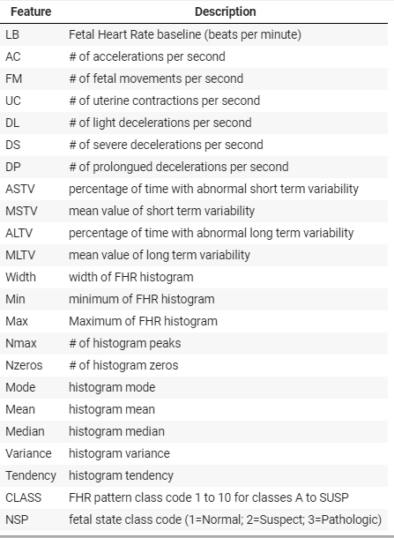
DATA DESCRIPTION
The data contains the diagnostic features of 2126 fetal Cardiotocograms. The data also contains classification labels assigned by expert obstetricians. There are a total of 21 features as explained here.
Cardiotocograms (CTG) are classified by three expert obstetricians and their majority opinion has defined the class of the cardiotocograms.
It comprised of pregnant women who were in the third trimester of pregnancy. The dataset consisted of 21 attributes used in the measurements of FHR and uterine contractions (UCs) on CTG.

Slide 7
DATA EXPLORATION

Slide 8
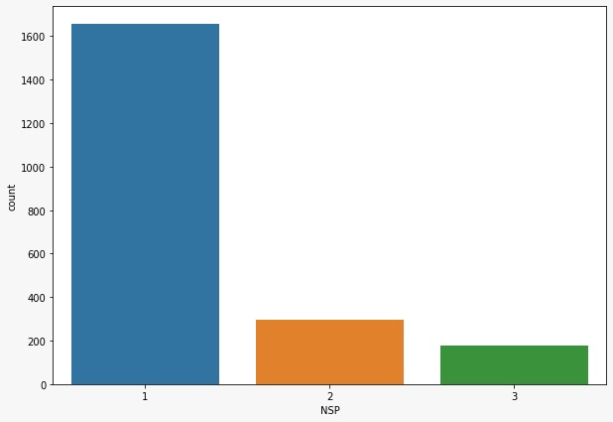
EXPLORATORY DATA ANALYSIS
OBSERVATION :
As can be seen from the results above Normal cases represents 78% of the data, Suspects constitutes 14% and the remaining 8% by Pathologic.
ANALYSIS :
This is not surprising given that these data are a sample of a real distribution of health conditions. A disease normally affects only a small part of the population while the majority are healthy.

Slide 9
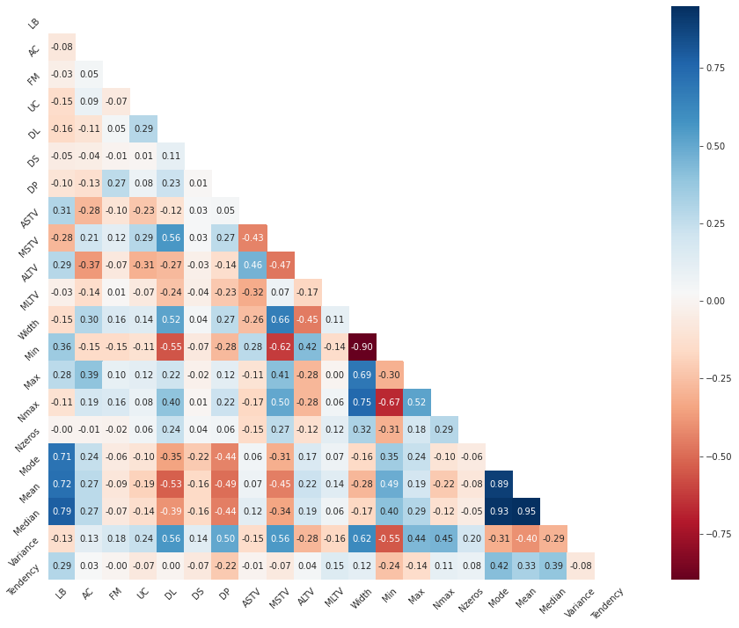
EXPLORATORY DATA ANALYSIS
Correlation Matrix of Independent Variable.
High negative correlation between width and Min.
Mode and Median are highly positively correlated.
Mode and Mean are also highly positively correlated.
Mean and Median are highly positive correlated.
LB have a moderate positive correlation with Mean, Median and Mode.
Tendency has almost no correlation with any of the features.

Slide 10
MODEL BUILDING

Slide 11
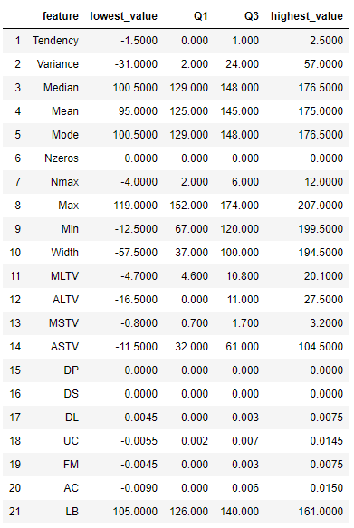
DATA PREPROCESSING
Merging of Classes
We have merged class 2 and class 3 as [+1] for the following reasons:
Class 2 and 3 represent the minority of elements in the data.
By doing this we can create a tool for doctors that can help them to recognize when a patient is at risk of having a pathological conditions.
Outlier Detection
There are total 21 outliers in the dataset.
2 outliers belongs to class -1 (healthy)
19 outliers belongs to class +1 (disease)
The outliers have been dropped from the further analysis.
Lowest Value = Q1 - 1.5 * IQR
Highest Value = Q3 + 1.5 * IQR
where, IQR (Inter Quartile Range) = Q3 - Q1

Slide 12
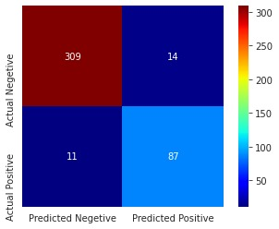
PRE-MODELLING
Confusion Matrix of Random Forest
Random Forest model has been implemented on the processed data.
We are more concerned with False Negatives since it detects disease patient as healthy.
We need to maximize all the four parameters mentioned below.
To do so we have implemented interaction effect.
F2 score : 0.88
Precision : 0.86
Recall : 0.88
Average precision-recall score: 0.79

Slide 13
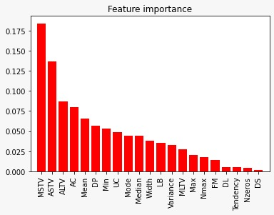
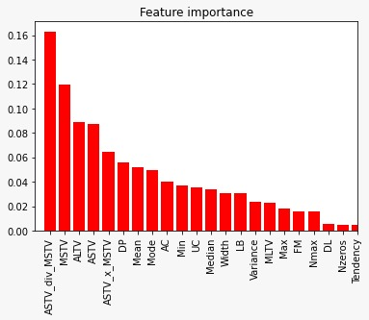
FEATURE IMPORTANCE
Two interaction has been introduced between MSTV and ASTV which are the most important feature.
ASTV * MSTV
ASTV / MSTV
Both the interaction variables turned out to be important features.
For further model building we have used features whose importance is more than 0.01. We have dropped

Slide 14
MODEL EVALUATION

Slide 15
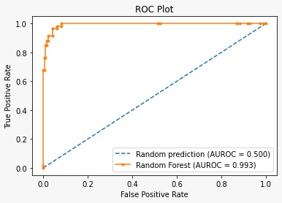
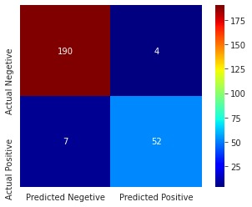
ML MODEL 1 : RANDOM FOREST
F2 Score : 0.89
Precision : 0.92
Recall : 0.88
Average precision-recall score: 0.85
Cohen’s kappa score : 0.78

Slide 16
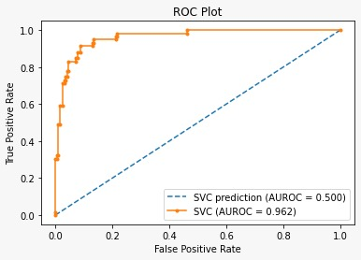
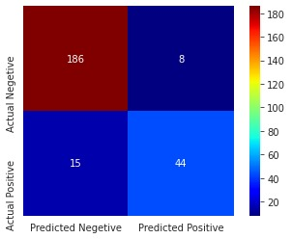
ML MODEL 2 : SVM
F2 Score : 0.76
Precision : 0.84
Recall : 0.74
Average precision-recall score: 0.69
Cohen’s kappa score : 0.73

Slide 17
CONCLUSION
The three categories belonging to the dependent variables NSP are having imbalanced distribution of data points, so for accuracy test we have used Cohen’s kappa score.
The most prominent risk factors depicted for fetal distress by the machine learning models were percentage of time with abnormal short-term variability, percentage of time with abnormal long-term variability, number of accelerations per second (AC).
Feature selection with the Random Forest Classifier gave a better performance than the base model.
The results showed that out of the two models, Random Forest Classifier can predict the classes more efficiently with an accuracy of 78% than SVM with an accuracy of 73%.

Slide 18
THANK YOU.

